Slide 1
Cryptography and System Security (CSS)
T.E – Sem.-VI
-Ms. Nabanita Mandal

Slide 2
Theorems
Fermat’s Theorem
Euler’s Theorem
Euclidean Algorithm

Slide 3
Prime number:
A prime number is divisible only by 1 and itself
For example: {2, 3, 5, 7, 11, 13, 17, …}
1 could also be considered prime, but it’s not very useful.

Slide 4
Prime Factorization:
To factor a number n is to write it as a product of other numbers.
n = a * b * c
Example: 100 = 5 * 5 * 2 * 2
Prime factorization of a number n is writing it as a product of prime numbers.
143 = 11 * 13

Slide 5
Relatively Prime Numbers
Relatively Prime Numbers
Two numbers are relatively prime if they have no common divisors other than 1.
Example: 10 and 21 are relatively prime, in respect to each other, as 10 has factors of 1, 2, 5, 10 and 21 has factors of 1, 3, 7, 21.
The Greatest Common Divisor (GCD) of two relatively prime numbers can be determined by comparing their prime factorizations and selecting the least powers.

Slide 6
Relatively Prime Numbers
For example, 125 = 5³ and 200 = 2³ * 5²
GCD(125, 200) = 2⁰ * 5² = 25
If the two numbers are relatively prime the GCD will be 1.
Consider the following: 10(1, 2, 5, 10) and 21(1, 3, 7, 21)
GCD(10, 21) = 1
It then follows, that a prime number is also relatively prime to any other number other than itself and 1.

Slide 7
Euler Totient Function Or Euler’s Phi Function
The Euler's totient function, or phi (φ) function is a very important number theoretic function having a deep relationship to prime numbers and the so-called order of integers.
The totient φ(n) of a positive integer n greater than 1 is defined to be the number of positive integers less than n that are coprime to n.

Slide 8
Euler Totient Function Or Euler’s Phi Function
The following table shows the function values for the first several natural numbers:
n | φ(n) | numbers coprime to n
1 | 1 | 1
2 | 1 | 1
3 | 2 | 1, 2
4 | 2 | 1,3
5 | 4 | 1,2,3,4
6 | 2 | 1,5
7 | 6 | 1,2,3,4,5,6
8 | 4 | 1,3,5,7
9 | 6 | 1,2,4,5,7,8
10 | 4 | 1,3,7,9
11 | 10 | 1,2,3,4,5,6,7,8,9,10
12 | 4 | 1,5,7,11
13 | 12 | 1,2,3,4,5,6,7,8,9,10,11,12
14 | 6 | 1,3,5,9,11,13
15 | 8 | 1,2,4,7,8,11,13,14

Slide 9
Can you find some relationships between n and φ(n)?
φ(1) is defined to be 1
φ(1) = 1
2. when n is a prime number (e.g. 2, 3, 5, 7, 11, 13),
φ(n) = n-1
3. when m and n are coprime or relatively prime,
φ(m*n) = φ(m)*φ(n)
If P is a prime,
φ(P^{e}) = P^{e} - P^{e - 1}

Slide 10
By combining all 4 rules,
The general formula to compute φ(n) is the following:
If the prime factorization of n is given by
n =p₁^{e1}* p₂^{e2}...........*p_{k}^{ek}
then
φ(n) = (p₁^{e1} - p₁^{e1 - 1} ) x (p₂^{e2} - p₂^{e2 - 1} ) x…x (p_{k}^{ek} - p_{k}^{ek - 1} )

Slide 11
Examples :
φ(13) = (13-1) = 12 ( use rule 2)
2. φ(10) (use rule 3)
φ(10) = φ(2) x φ(5) = (2-1) x (5-1) = 1 x 4 = 4
….as 2 and 5 are prime
3. φ(240) = 2⁴ x 3¹ x 5¹ ……(use rule 4)
= (2⁴ - 2³ ) x (3^{1 _} 3⁰ ) x (5^{1 _} 5⁰ ) = 64

Slide 12
4. φ(49) = φ( 7²) = 7² – 7¹ = 42
….use rule 3 not 2 as m and n are relatively prime.
5. φ(14) = φ(7) x φ(2) = 6 x 1 = 6
( 1,3,5,9,11,13)

Slide 13

Fermat’s Little Theorem
If p is prime and a is an integer not divisible by p, then
a^{p-1} 1 (mod p).
And for every integer a and p is prime
a^{p} a (mod p).
This theorem is useful in public key (RSA) and primality testing.

Slide 14

Euler’s theorem
Euler’s theorem uses modulus arithmetic which helps to lay the foundation for RSA encryption.
To construct a personal cipher key we need an appropriate value we will call variable R.
So, we select two very large prime numbers U and V and multiply them.
(R) = (U-1)*(V-1).
This makes R difficult to factor, since the fewer factors a number has, the longer it takes to find them.

Slide 15
Euler’s theorem
We also define the variables P and Q. P is an arbitrary number that is relatively prime to (R). Q is the calculated inverse of P in (mod (R)).
We use P and R to create a public key, and Q and R to create a private key.
This yields P*Q 1(mod (R) ).
Information in these slides compiled by Christopher Simons

Slide 16
Integer Arithmetic
In integer arithmetic, if we divide a by n, we can get q
And r .
The relationship between these four integers can be shown as
a = q × n + r
2.<number>

Slide 17
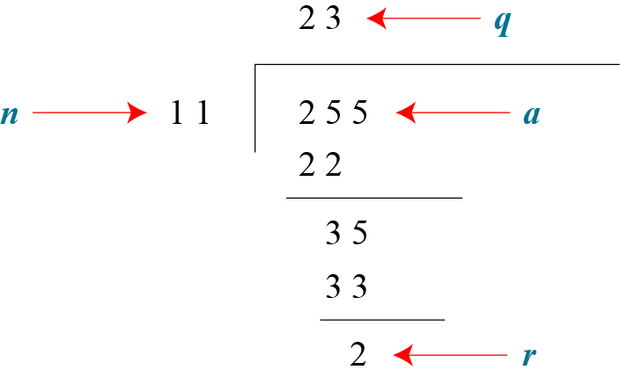
Integer Arithmetic
a = q × n + r
Assume that a = 255 and n = 11. We can find q = 23 and r = 2 using the division algorithm.
2.<number>

Slide 18
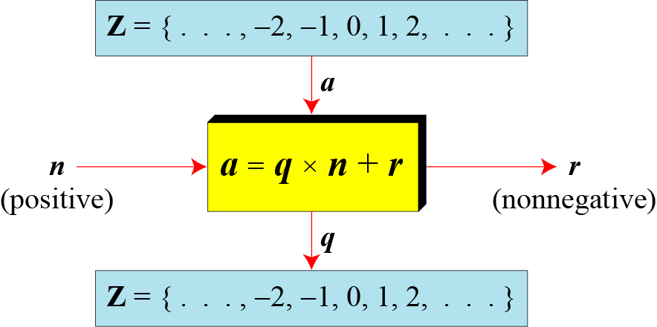
Division Algorithm for Integers
2.<number>

Slide 19
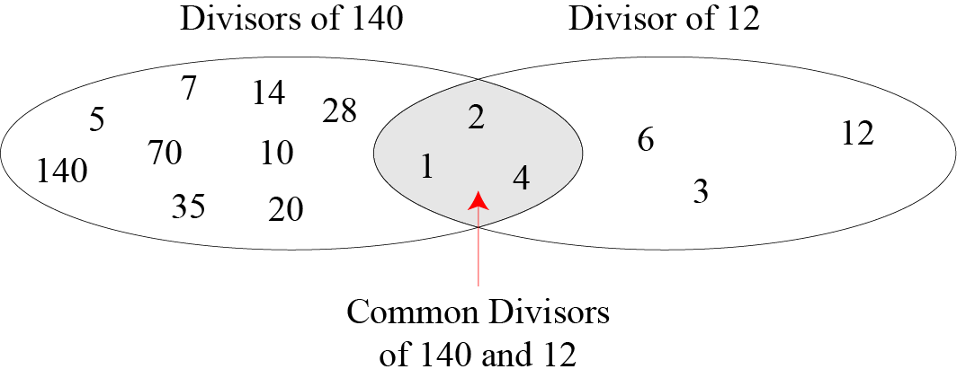
Common divisors of two Integers
The greatest common divisor (GCD) of two positive integers is the largest integer that can divide both integers.
2.<number>

Slide 20
Euclidean Algorithm
Fact 1: gcd (a, 0) = a
Fact 2: gcd (a, b) = gcd (b, r), where r is the remainder of dividing a by b
When gcd (a, b) = 1, we say that a and b are relatively prime.

Slide 21
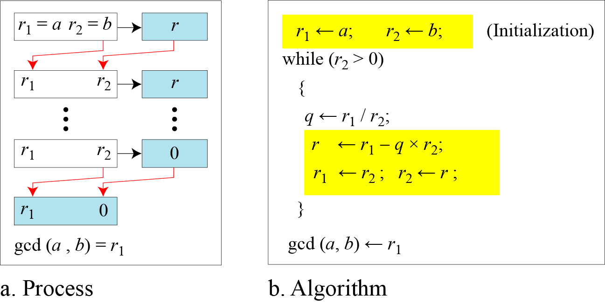
Euclidean Algorithm

Slide 22
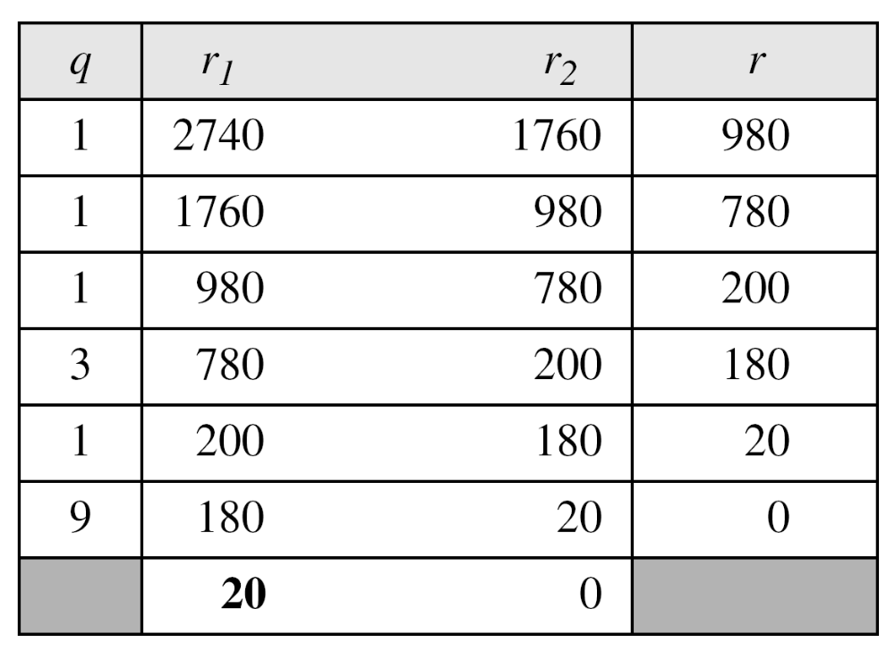
Euclidean Algorithm
Find the greatest common divisor of 2740 and 1760.
We have gcd (2740, 1760) = 20

Slide 23

Extended Euclidean Algorithm
Given two integers a and b, we often need to find other two integers, s and t, such that
The extended Euclidean algorithm can calculate the gcd (a, b) and at the same time calculate the value of s and t.

Slide 24
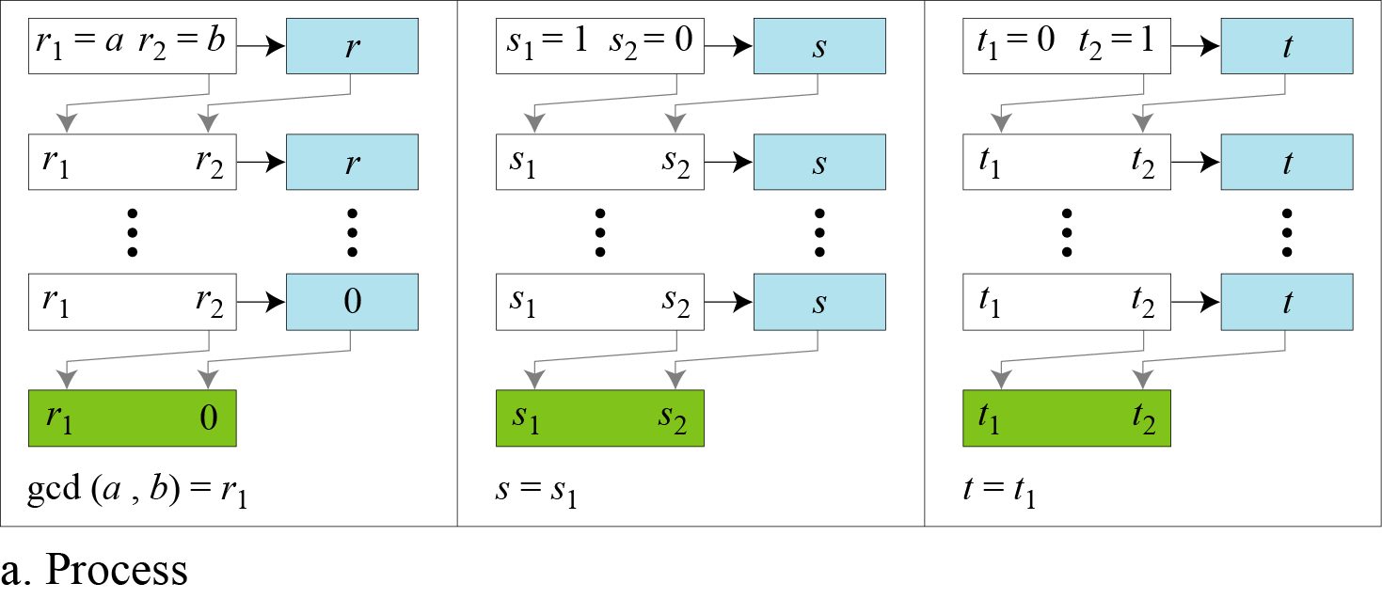
Extended Euclidean Algorithm

Slide 25
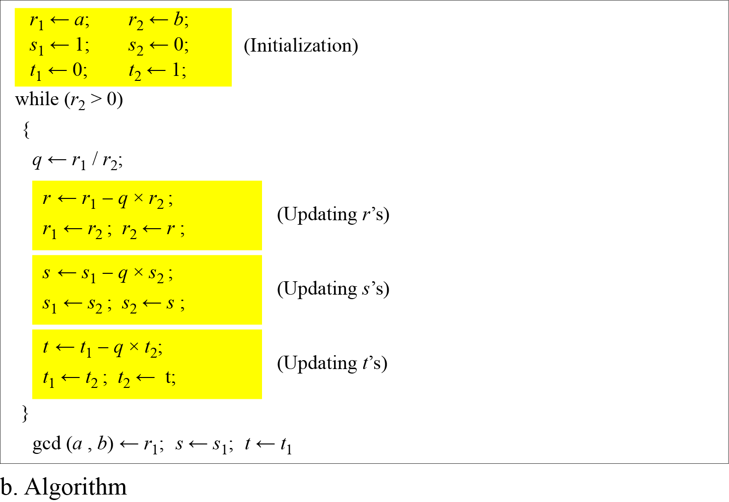
Extended Euclidean Algorithm

Slide 26
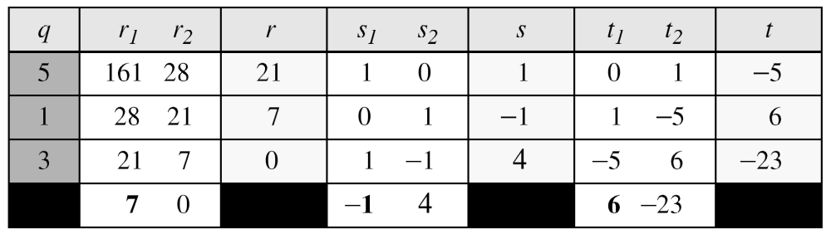
Extended Euclidean Algorithm
Given a = 161 and b = 28, find gcd (a, b) and the values of s and t.
We get gcd (161, 28) = 7, s = −1 and t = 6.

Slide 27
Extended Euclidean Algorithm
The extended Euclidean algorithm finds the multiplicative inverses of b in Z_{n} when n and b are given and gcd (n, b) = 1.
The multiplicative inverse of b is the value of t after being mapped to Z_{n}.

Slide 28
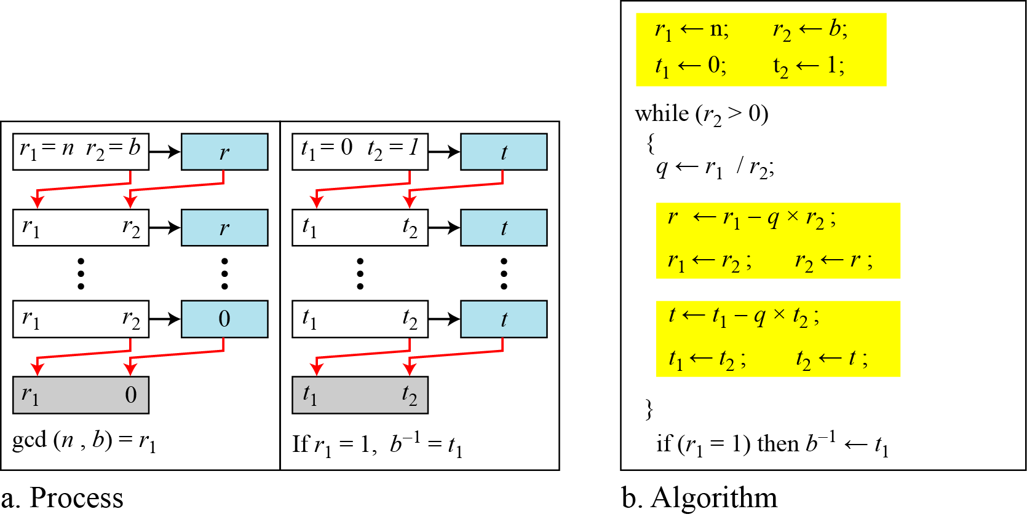
Extended Euclidean Algorithm to find Multiplicative Inverse

Slide 29
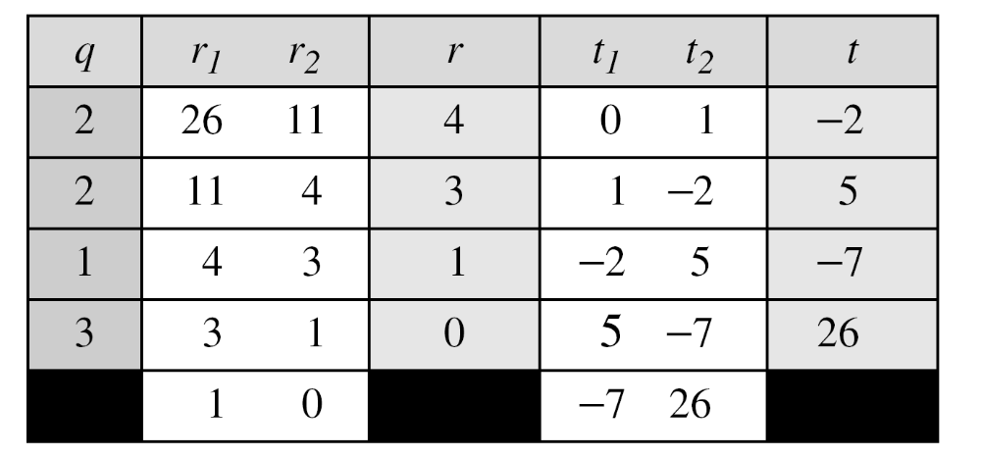
Extended Euclidean Algorithm to find Multiplicative Inverse
Find the multiplicative inverse of 11 in Z₂₆.
The gcd (26, 11) is 1; the inverse of 11 is −7 or 19.

Slide 30
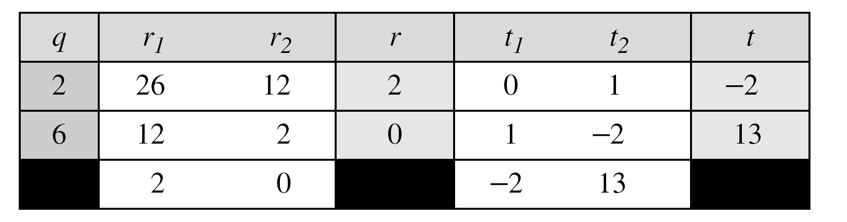
Extended Euclidean Algorithm to find Multiplicative Inverse
Find the inverse of 12 in Z₂₆.
The gcd (26, 12) is 2; the inverse does not exist.

